Slide 1

Web Development & Design Foundations with H T M L 5
Ninth Edition
Chapter 11
Web Multimedia and Interactivity
Slides in this presentation contain hyperlinks. JAWS users should be able to get a list of links by using INSERT+F7
Copyright © 2019, 2017, 2015 Pearson Education, Inc. All Rights Reserved
Notes:
If this PowerPoint presentation contains mathematical equations, you may need to check that your computer has the following installed:
1) MathType Plugin
2) Math Player (free versions available)
3) NVDA Reader (free versions available)

Slide 2
Learning Objectives (1 of 2)
11.1 Describe the purpose of plug-ins, helper applications, media containers, and codecs
11.2 Describe types of multimedia files used on the Web
11.3 Configure hyperlinks to multimedia files
11.4 Configure audio and video on a web page with HTML5 elements
11.5 Describe features and common uses of Adobe Flash, JavaScript, Java applets, Ajax, and jQuery

Slide 3
Learning Objectives (2 of 2)
11.6 Configure a Flash animation on a web page
11.7 Describe how to configure a Java applet on a web page
11.8 Create an interactive image gallery with C S S
11.9 Configure a widget with the HTML5 details and summary elements
11.10 Configure the C S S3 transform and transition properties
11.11 Describe the purpose of geolocation, web storage, offline web applications, and canvas HTML5 APIs.

Slide 4
Helper Applications & Plug-Ins
Helper Application
A program that can be designated to handle a particular file type (such as .wav or .mpg) to allow the user to view or otherwise utilize the special file.
The helper application runs in a separate window from the browser.
Plug-In
A newer and more common method
Plug-ins run right in the browser window so that media objects can be integrated directly into the web page.

Slide 5
Containers & Codecs
Container
Designated by the file extension – contains the media and metadata
Codec
The algorithm used to compress the media
H T M L5 audio & video
Native to the browser
Issue: Browsers do not all support the same codecs
http://www.longtailvideo.com/html5/

Slide 6
Commonly Used Plug-Ins
Adobe Flash Player
Adobe Reader
Windows Media Player
Apple Quicktime

Slide 7
Common Audio File Types
.w a v | Wave File
.aiff | Audio Interchange File Format
.mid | Musical Instrument Digital Interface (M I D I)
.a1u | Sun UNIX sound file
.mp3 | M P E G-1 Audio Layer-3
.ogg | Ogg Vorbis (open-source)
.m4a | M P E G 4 Audio. This audio-only M P E G-4 format is supported by Quicktime, iTunes, and iPods.

Slide 8
Common Video File Types
.mov | Quicktime
.avi | Microsoft Audio Video Interleaved
.wmv | Windows Media File
.flv | Flash Video File
.mpg | M P E G (Motion Picture Experts Group)
.m4v .mp4 | (M P E G-4)
.ogv | Ogg Theora (open-source)
.webm | V P8 codec (open video format, free)

Slide 9
Copyright Issues
Only publish web pages, images, and other media that you have personally created or have obtained the rights or license to use.
Ask permission to use media created by another person instead of simply “grabbing” it.
All work (including web pages) are automatically copyrighted even if there is not copyright mark or date.
Fair Use Clause of the Copyright Act
Creative Commons – A new approach to copyright

Slide 10

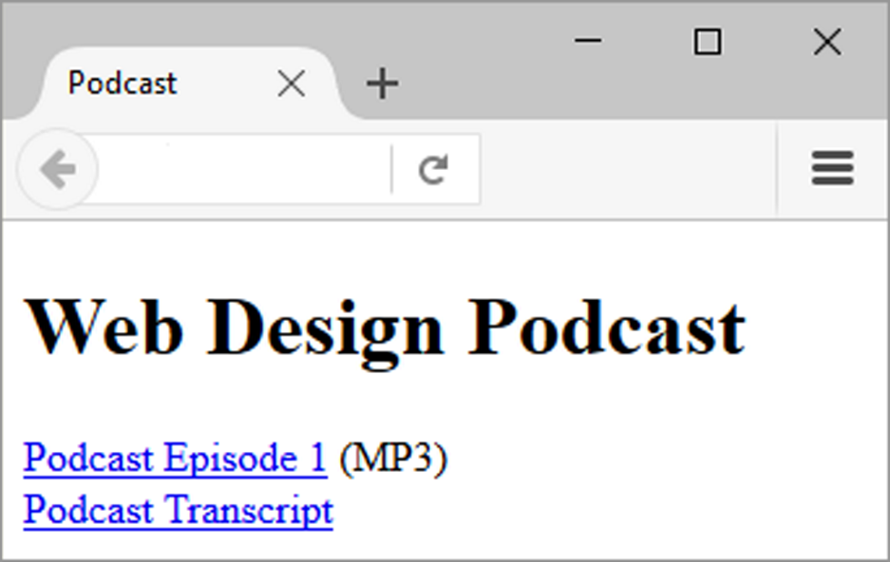
Configure Audio & Video
Most basic method to provide audio or video files:
Hyperlink

Slide 11
Multimedia & Accessibility (1 of 2)
Provide alternate content
Transcript (for audio)
Captions (for video)
Text format

Slide 12
What is Adobe Flash?
A popular multimedia application
Create multimedia which adds visual interest and interactivity to web pages
Flash movies are saved in “.s w f” files
Perception of speedy display
.s w f files play as they download
Flash Player
Free browser plug-in
Widely installed on desktop browsers but not well-supported by mobile devices

Slide 13
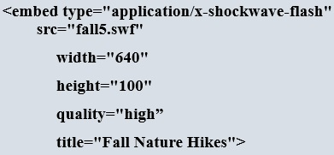
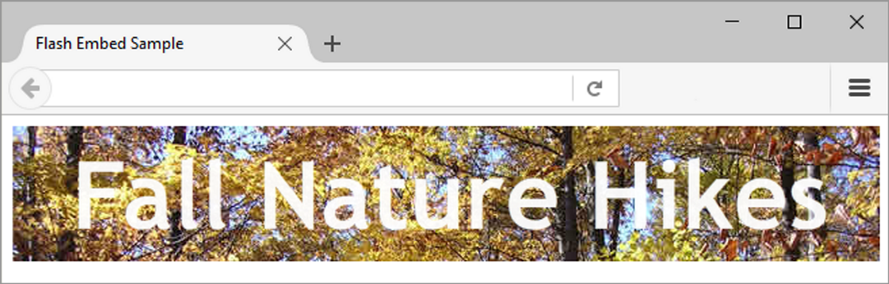
H T M L5 Embed Element

Slide 14
Checkpoint 11.1
List three common web browser plug-ins and describe their use.
Describe issues involved with adding media such as audio or video to a web page.
Describe a disadvantage of using Flash on a web page.

Slide 15
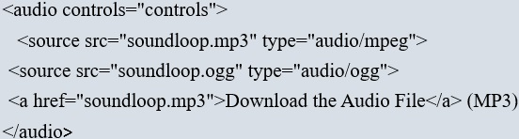
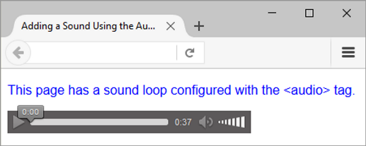
H T M L5 Audio & Source Elements

Slide 16
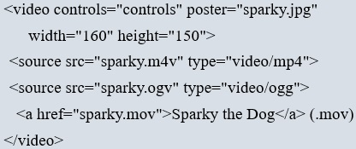
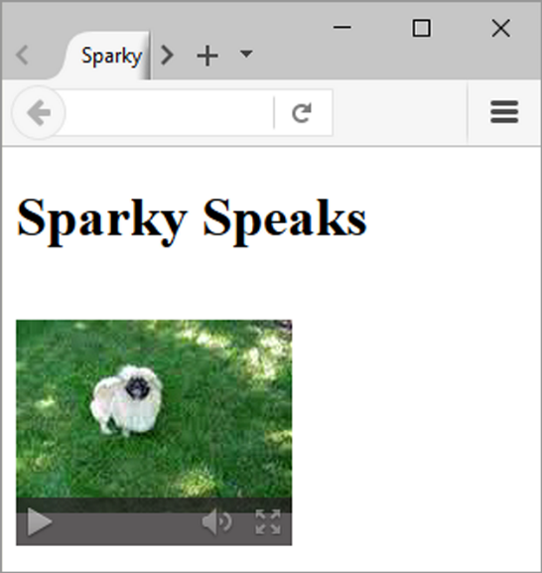
H T M L5 Video & Source Elements

Slide 17
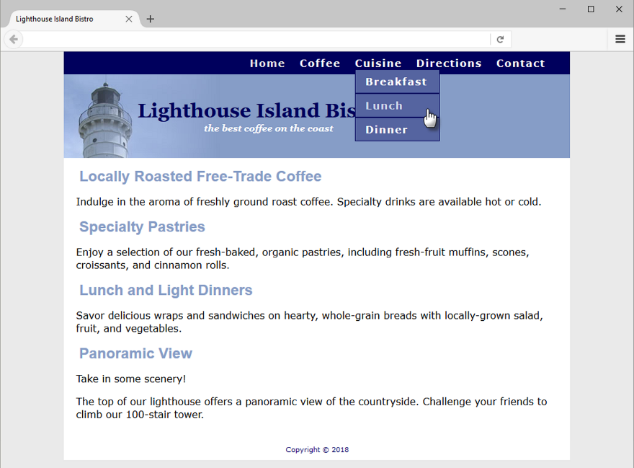
C S S Drop Down Menu
Configure nav container with position relative
Code submenu (drop down menu) u l element with the parent li element
Configure submenu u l element to initially not display
Configure submenu u l element with absolute positioning

Slide 18
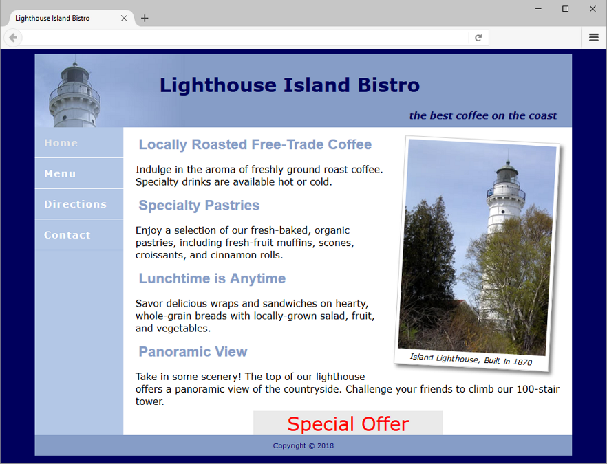
C S S3 Transform Property
Allows you to rotate, scale, skew, or move an element
Example:

Slide 19
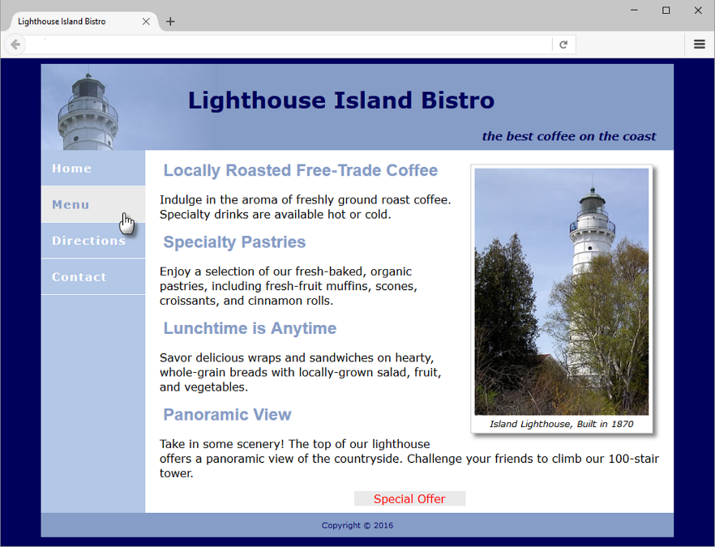
C S S3 Transition Property
Provides for changes in property values to display in a smoother manner over a specified time.
Example:

Slide 20
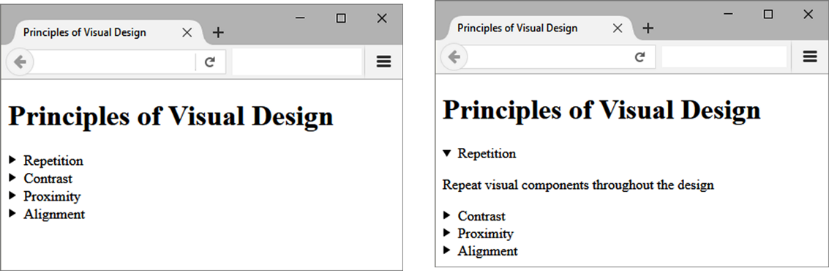
HTML Details & Summary Elements
Used together to configure an interactive widget
Details element contains one summary element and detailed information
Summary element contains the text initially displayed

Slide 21
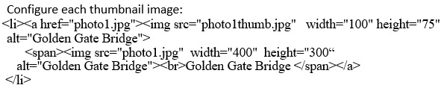
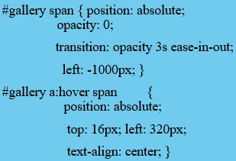
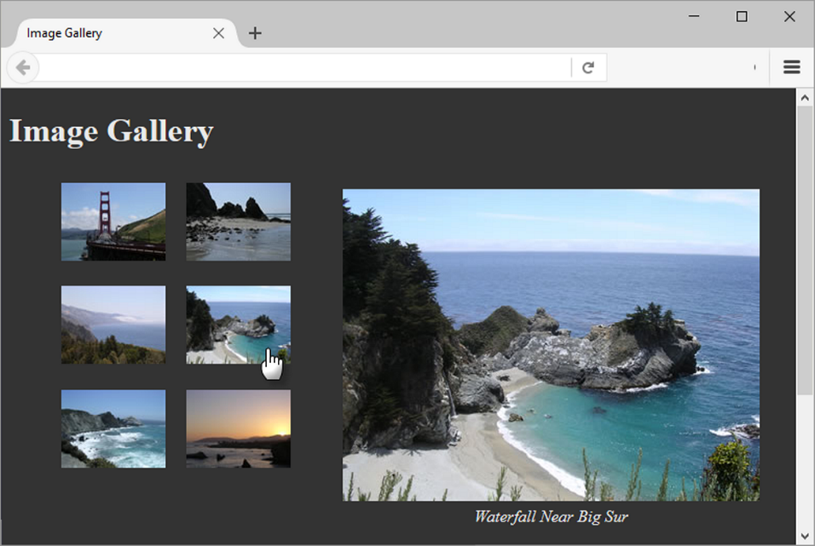
C S S Image Gallery
The key C S S:

Slide 22
What is Java?
Object Oriented Programming (O O P)
Developed by Sun Microsystems
Java is not the same language as JavaScript.
Java is more powerful and much more flexible than JavaScript.
Java can be used to:
develop stand-alone executable applications
applets that are invoked by Web pages

Slide 23
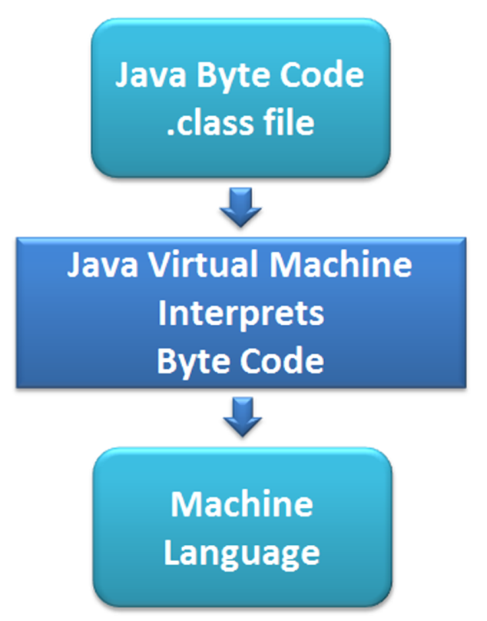
Java Applets
Compiled -- translated from the English-like Java statements to an encoded form called Byte Code.
Use the “.class” file extension
Java Virtual Machine (J V M)
interprets the byte code into the proper machine language for the operating system
After translation, the applet is executed and appears on the Web page.

Slide 24
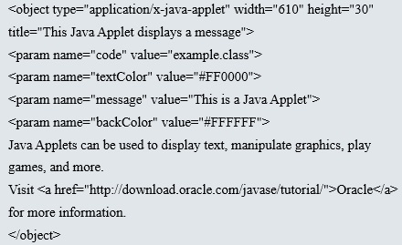
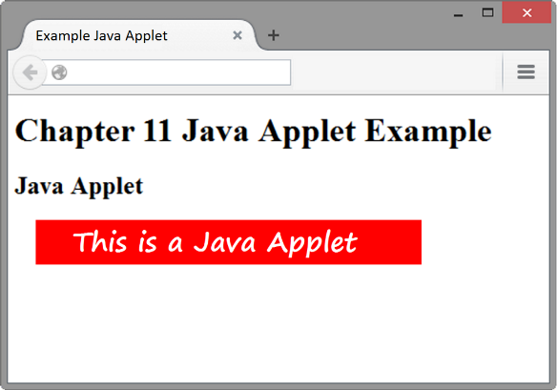
Adding a Java Applet to a Web Page
Obsolete: the applet element
H T M L5: the object element

Slide 25
Checkpoint 11.2
Describe a benefit of using the new H T M L 5 video and audio elements.
Describe the purpose of the transform property.
Describe a disadvantage of using Java applets on web pages.

Slide 26
What is Javascript?
Object-based client-side scripting language
Originally developed by Brendan Eich at Netscape
JavaScript is not Java
Manipulates the objects associated with a web page document:
the window
the document
the elements such as forms, images, hyperlinks, and so on

Slide 27
Common Uses of Javascript
Display a message box
Select list navigation
Edit and validate form information
Create a new window with a specified size and screen position
Image Rollovers
Status Messages
Display Current Date
Calculations

Slide 28
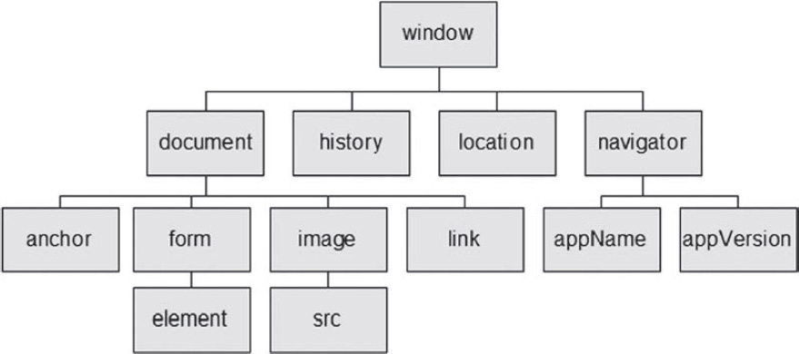
Document Object Model (D O M)
A portion of the D O M is shown at the left.
Defines every object and element on a Web page
Hierarchical structure
Accesses page elements and apply styles to page elements

Slide 29
What is Ajax?
Asynchronous JavaScript and X M L
“Ajax” – Jesse James Garrett at Adaptive Path
Existing technologies used in a new way
Standards-based X H T M L and C S S
Document Object Model
X M L (and the related X S L T technology)
Asynchronous data retrieval using X M L H t t p Request
JavaScript
Very Basic Example:
http://webdevfoundations.net/css

Slide 30
Exploring JQuery (1 of 2)
A JavaScript library intended to simplify client-side scripting
Example: http://webdevfoundations.net/jquery
A P I – Application Programming Interface
A protocol that allows software components to communicate – interacting and sharing data.

Slide 31
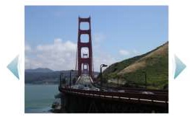
Exploring JQuery (2 of 2)
The jQuery A P I can be used to configure many interactive features, including:
image slideshows
animation (moving, hiding, fading)
event handling (mouse movements and mouse clicking)
document manipulation
Ajax
jQuery Slideshow Example

Slide 32
H T M L5 A P I s
A P I – a protocol that allows software components to communicate – interacting and sharing data
A variety of A P I s that are intended to work with H T M L 5, C S S, and JavaScript are currently under development and in the W3C approval process, including:
geolocation
web storage
offline web applications
canvas

Slide 33
H T M L5 Geolocation
Allows your web page visitors to share their geographic location
Their location may be determined by the I P address, wireless network connection, local cell tower, or G P S hardware depending on the type of device and browser.
JavaScript is used to work with the latitude and longitude coordinates provided by the browser.
Examples:
http://webdevfoundations.net/geo and http://html5demos.com/geo

Slide 34
H T M L5 Web Storage (1 of 2)
Traditionally, the JavaScript cookie object has been used to store information in key-value pairs on the client (the website visitor’s computer).
New for H T M L5: Web Storage A P I
provides two new ways to store information on the client side: local storage and session storage.
Advantage: increase in the amount of data that can be stored (5 M B per domain).
The localStorage object stores data without an expiration date.

Slide 35
H T M L5 Web Storage (2 of 2)
The sessionStorage object stores data only for the duration of the current browser
JavaScript is used to work with the values stored in the localStorage and sessionStorage objects.
Examples:
http://webdevfoundations.net/storage and http://html5demos.com/storage

Slide 36
H T M L5 Offline Web Applications
An offline web application enables website visitors to view documents and access web applications even when they are not connected to the Internet.
A web application (app) can be written with H T M L, C S S and JavaScript and can run in any browser – as long as you are online.
An offline web application takes this one step further and stores the H T M L, C S S, and JavaScript files on the visitor’s device for use offline, even when the device is not connected to the Internet.
Examples:
https://html5demos.com/offlineapp
http://www.w3schools.com/html/html5_app_cache.asp

Slide 37
H T M L5 Canvas Element (1 of 2)
Configures dynamic graphics
Draw lines, shapes, text, image
Interact with actions taken by the user
Canvas A P I (application programming interface)
JavaScript – client-side scripting language

Slide 38
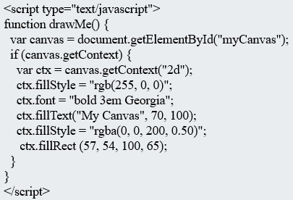
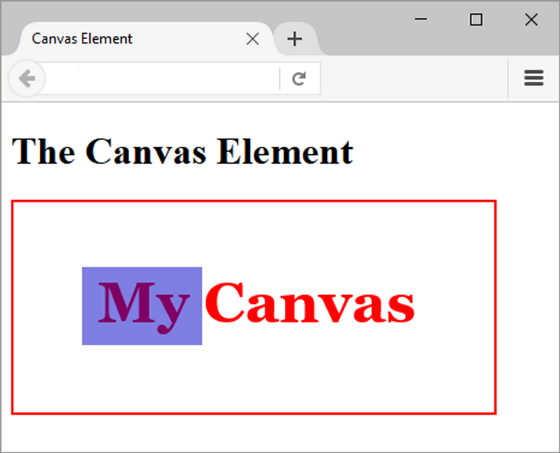
H T M L5 Canvas Element (2 of 2)

Slide 39
Checkpoint 11.3
Describe two uses of JavaScript.
Describe two technologies used in Ajax.
Describe the purpose of the H T M L5 canvas element.

Slide 40
Multimedia & Accessibility (2 of 2)
Provide links to plug-ins
Provide text descriptions and captions
Verify keyboard access
Check for screen flickering
Verify functionality if JavaScript is disabled
If media is used for main navigation, provide plain text links

Slide 41
Summary
This chapter introduced the H T M L & C S S techniques and technologies used to configure sound, video, and interactivity on web pages.
Issues related to accessibility and copyright were also discussed.
The number one reason for visitors to leave web pages is too long of a download time. When using multimedia, be careful to minimize this issue.

Slide 42

Copyright

